Slide 1
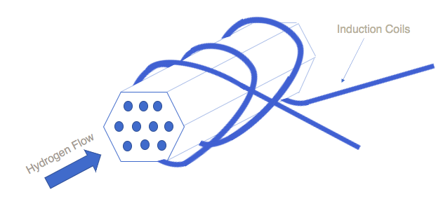
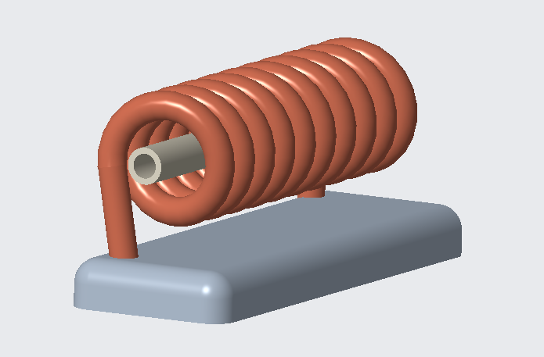
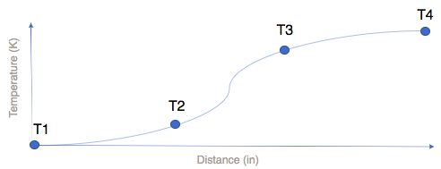
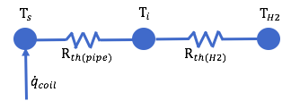
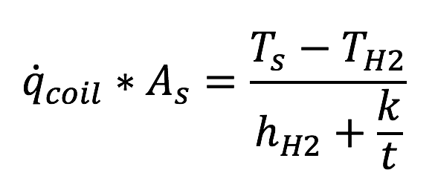
Team 514: Hydrogen Pre-Heater in the Nuclear Thermal Rocket Simulation
Michael Corak – Kevin Hartzog – Fisher Hillburn – Jordan Weid
Project Description
Selected Design
Governing Physics
The objective of this project is to create a device that allows for independent control of the inlet temperatures of hydrogen supply to the test articles and mounts to a variety of test article shapes and sizes.
Assumptions
No radiation heat transfer
Constant heat flux
Ideal gas
All heat transfer on surface of heat exchanger enters fluid
Background/Motivation
Test article
Induction coil
NASA's NTREES (Nuclear Thermal Rocket Element Environment Simulator) currently simulates the conditions found in a nuclear fuel element in a nuclear thermal rocket with a 20-inch test article. The true size on the rocket is 50 inches, so in order to properly simulate varying temperatures across the true length, a pre-heater must be used. The images below show what a temperature profile might look like with axial distance and a comparison of the true length to simulation length.
H2
Thermal Resistance Network
CAD Rendering
Selected Design Characteristics
Control – Potentiometer
Heating – Induction Heating
Mounting - Composite plate
Heat Exchanger Shape - Cylindrical
Interface to Test Article – Not yet decided

